Slide 1
Radioisotopes in industry
© The University of Western Australia | for conditions of use see spice.wa.edu.au/usage | ast0331 | version 0.9

Slide 2
The blast furnace
case one

Slide 3
to stockpile of iron ore
conveyor belt
iron ore
hopper
blast furnace

Slide 5
radioisotopes
detectors

Slide 6
The filling line
case two

Slide 7
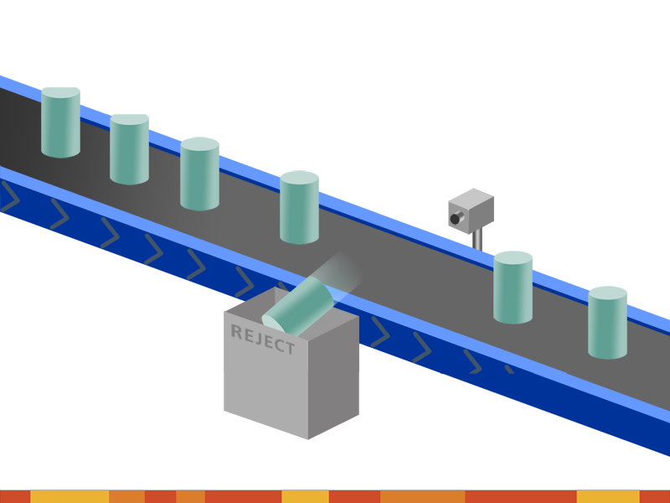

Slide 8
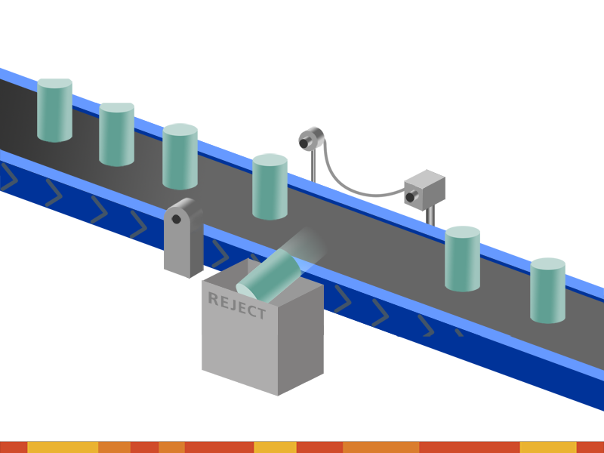
detector
activated air blast
radioisotope

